Slide 1
Discrete Structures Project: React
By Anthony Williams

Slide 2
Introduction
What is React?
An open-source front-end JavaScript library that helps software developers build user interfaces using UI components
Maintained since 2013 by Meta (formerly Facebook) and a group of individual companies and developers
Helps developers create single-page and mobile applications

Slide 3
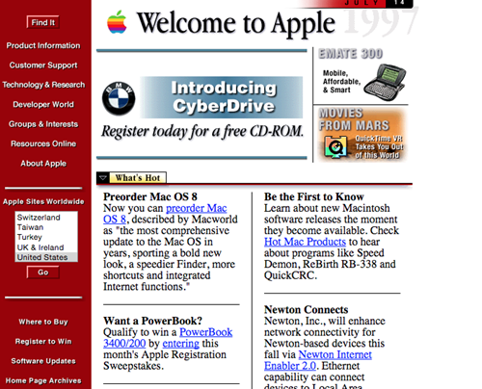

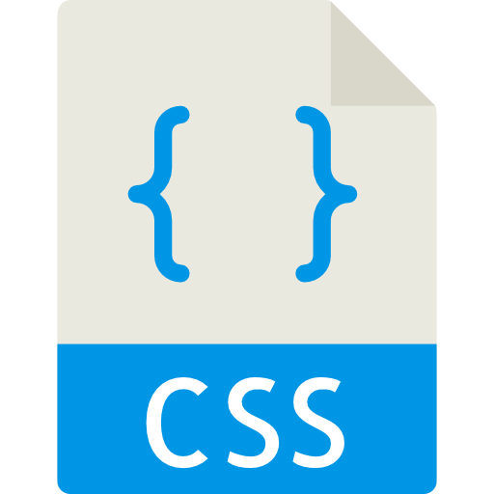
Before the React Landscape
In the early 1990s web pages were static
Consisting only of HTML & CSS

Slide 4
The Early JavaScript Landscape
Created in 1995 by Netscape engineer Brendan Eich
Included in the release of Netscape’s Navigator browser
Microsoft released Internet Explorer in 1995 following the Navigator browser
Microsoft reverse-engineered the Navigator browser and created JScript to mimic its features
The start of the browser war (many companies creating browsers)
Different standards make it difficult for developers to make their websites work correctly in the various browsers

Slide 5

Enter JQuery
A Javascript library created to simplify DOM manipulation
Provides developers with a unified API
One of the best solutions when implementing JavaScript interactivity at the time

Slide 6

Websites Become Applications
Websites became more complex
Increased functionality means more complexity
Leading to web applications outgrowing JQuery’s functionality

Slide 7


Enter Single Page Applications
To manage the growing complexity, libraries like Backbone.js were created
AJAX (Asynchronous Javascript and XML) functionality ushered in the birth of single page applications

Slide 8

What is A Single Page Application?
Less time gets spent developing the application in HTML, and more time is spent on Javascript
The web page is only loaded once instead of a request for each page
Page updates happen via JavaScript (To request new data and repaint content)

Slide 9

Continued Attempts to Solve the Problem
Google releases Angular JS in 2010
Initially adopted by the developer community
Eventually using Angular would become more complex than the problem it was trying to solve

Slide 10

React’s Release and Popularity
Facebook releases React in 2013
Reimagines how front-end applications are built and designed
With React’s release Google decides to rewrite Angular to simplify it
Combined with Google’s rewrite and React’s new ideas caused developers to adopt React
Facebook (was trusted at the time)

Slide 11






React Today
Some of the biggest companies use React
Many frameworks implement React into their libraries

Slide 12
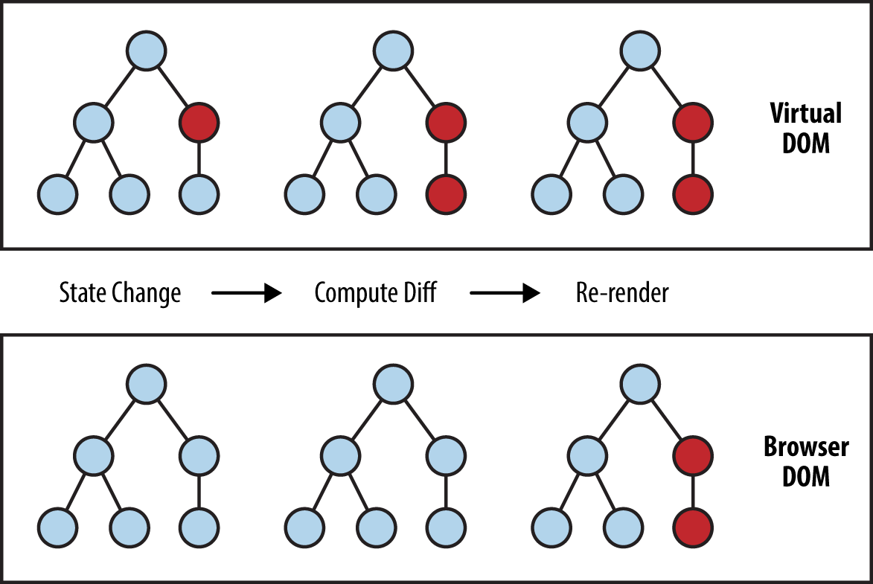
How does React Work (1 of 3)
The first of React’s three main ideas: Virtual DOM
DOM manipulation is a performance-heavy task
To handle DOM manipulation a JavaScript object must be declared
This object is called state
The application’s data is called application state
Declarative paradigm
Results in less cless complexity, faster development times, and better code quality

Slide 13
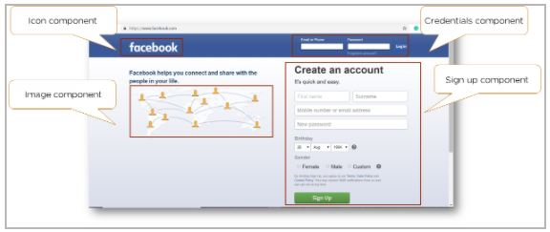
How does React Work (2 of 3)
The second of React’s three main ideas: Components
Components are like legos
Smaller components are put together to form bigger components
For example, a component could be a (navigation bar, profile picture, or menu item
Components are meant to be reusable
Components are implemented as simple functions that display output to the user

Slide 14
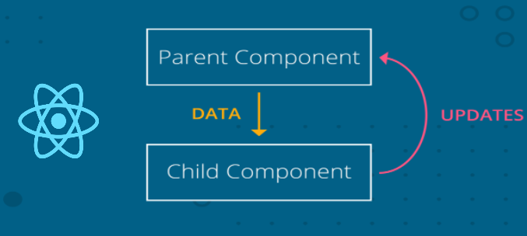
How does React Work (3 of 3)
The third of React’s three main ideas: One-way data flow
All application’s data flows downward direction
One-way data flow makes React applications more performant
Parent components hold application state
Parent components pass a snapshot of data to child components
Allows for easier debugging

Slide 15
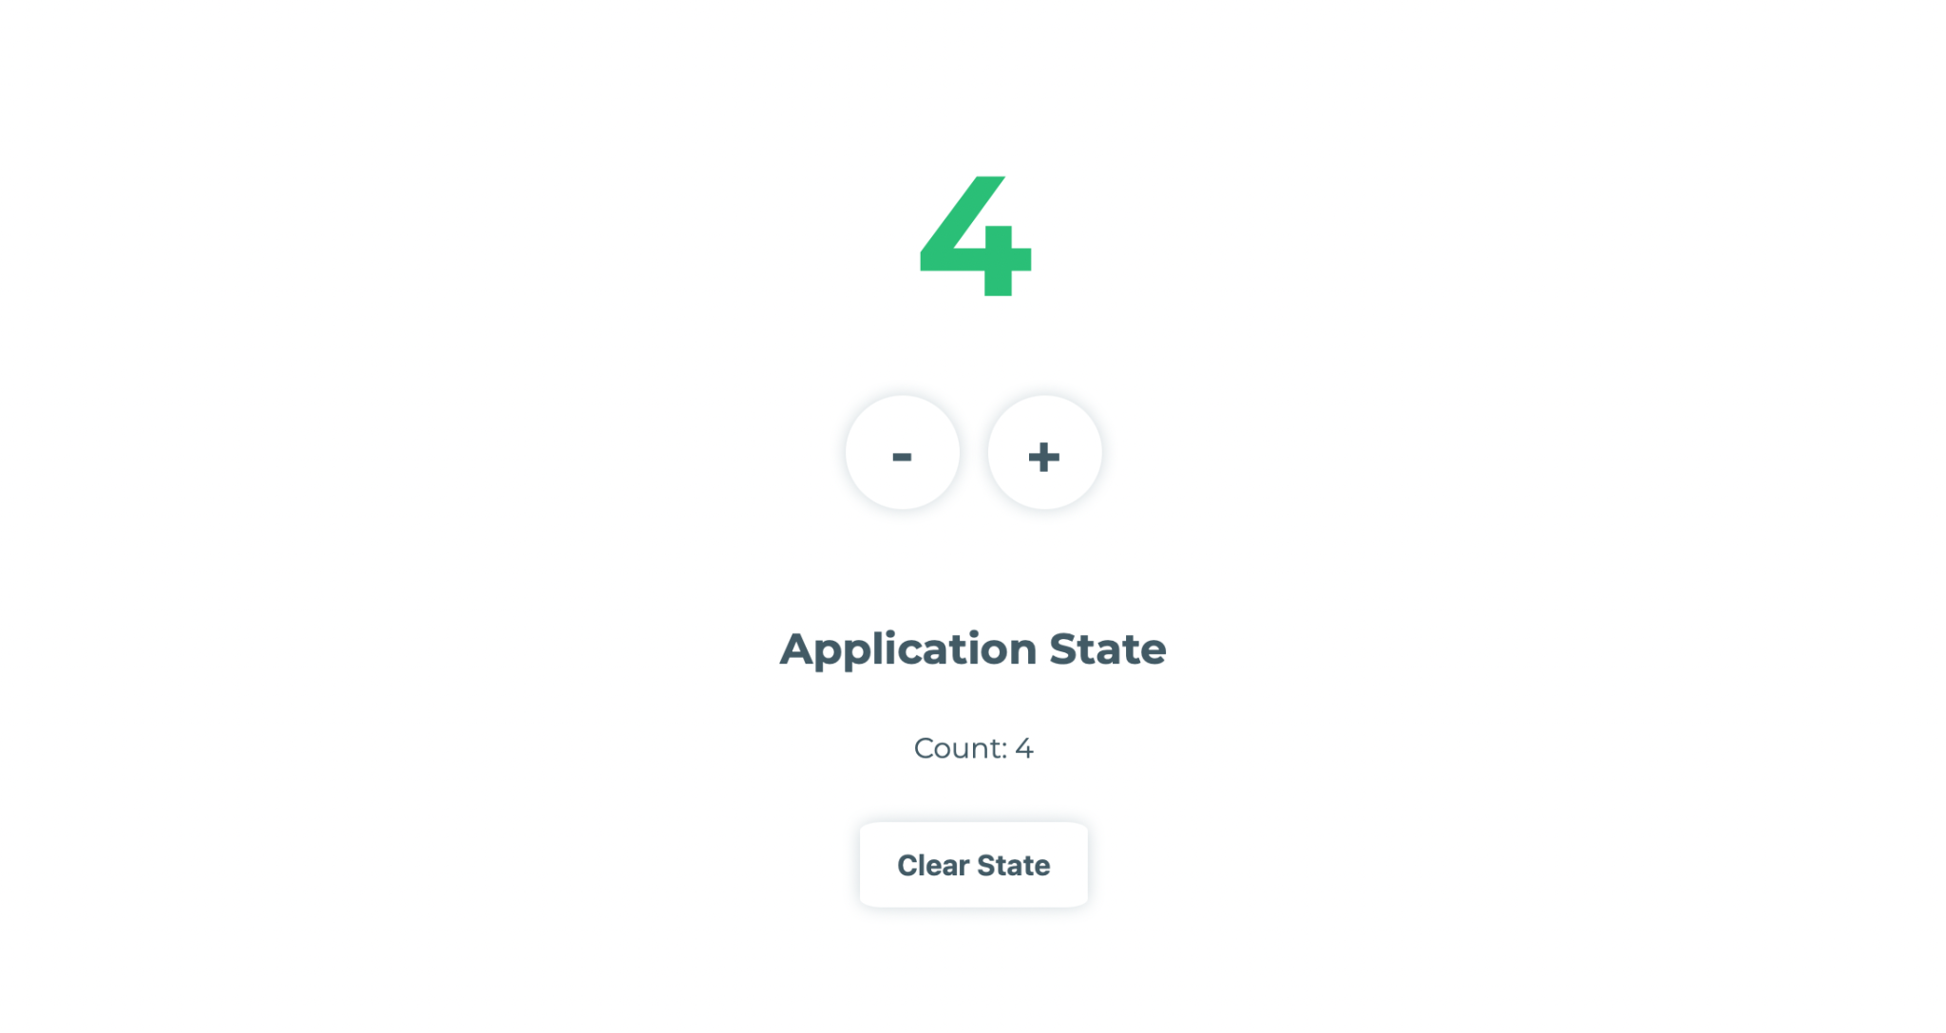
Conclusion
Example: Simple Counter App
Simple score counter application
Displays application’s current state
Can increment and decrement score on button click
Live link: https://codepen.io/awllmscs/pen/gOGwKEd

